Slide 1
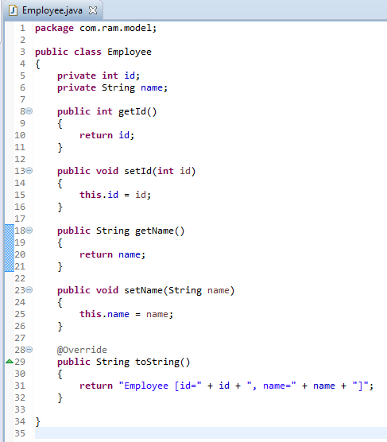
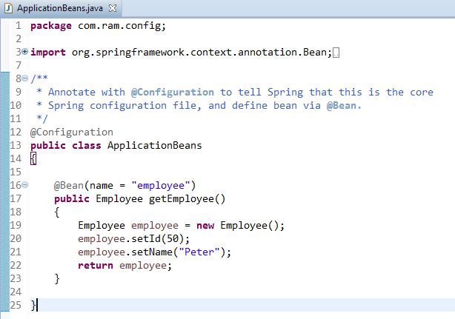
Spring JavaConfig [Configuring spring beans without XML]
Define a class which act as a spring beans tag and which should contain a method which produces bean.
Now employee bean is configured in the below configuration class.

Slide 2
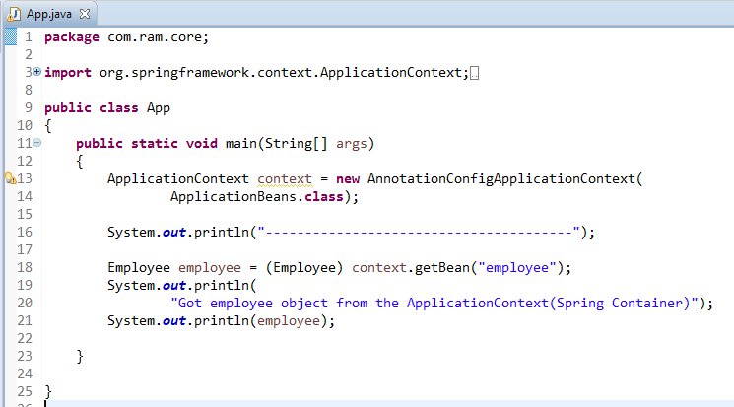
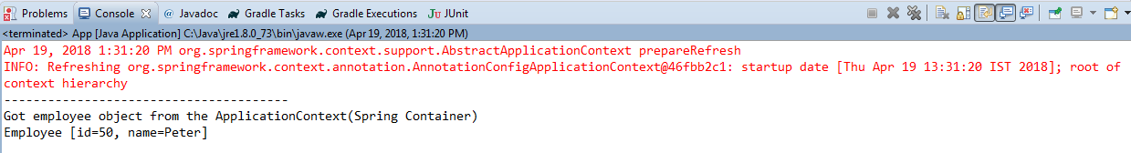
Spring JavaConfig [Configuring spring beans without XML]

Slide 3
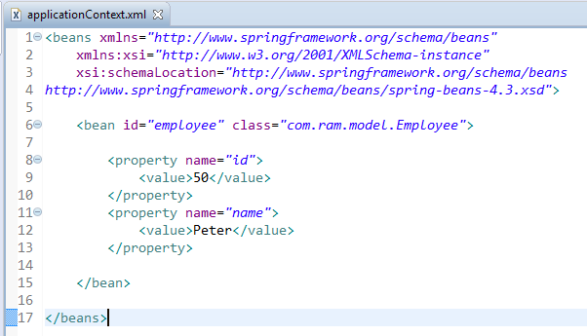
Spring JavaConfig [Configuring spring beans without XML]
Since Spring 3, JavaConfig features are included in core Spring module, it allow developer to move bean definition and Spring configuration out of XML file into Java class.
But, we are still allow to use the classic XML way to define beans and configuration, the JavaConfig is just another alternative solution.
See the different between classic XML definition and JavaConfig to define a bean in Spring container.
Spring XML file
Equivalent configuration in JavaConfig

